Slide 2
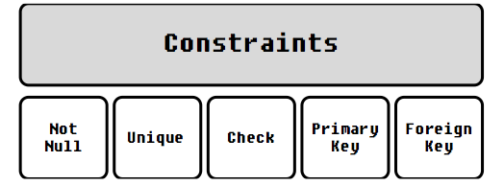
SQL - Constraints
Constraints are the rules enforced on the data columns of a table.
Constraints could be either on a column level or a table level
The column level constraints are applied only to one column, whereas the table level constraints are applied to the whole table.

Slide 3
SQL - Constraints
NOT NULL: we cannot store a null value in a column. That is, if a column is specified as
NOT NULL.
UNIQUE: This constraint when specified with a column, tells that all the values in the column must be unique. That is, the values in any row of a column must not be repeated. null value accepted
PRIMARY KEY: A primary key is a field which can uniquely identify each row in a table. And this constraint is used to specify a field in a table as primary key. null value not accepted
FOREIGN KEY: A Foreign key is a field which can uniquely identify each row in a another table. And this constraint is used to specify a field as Foreign key.
CHECK: This constraint helps to validate the values of a column to meet a particular condition. That is, it helps to ensure that the value stored in a column meets a specific condition.

Slide 4
Syntax
CREATE TABLE sample_table
( column1 data_type(size) constraint_name,
column2 data_type(size) constraint_name,
column3 data_type(size) constraint_name, .... );
sample_table : Name of the table to be created.
data_type : Type of data that can be stored in the field. constraint_name : Name of the constraint.
for example- NOT NULL, UNIQUE, PRIMARY KEY etc.

Slide 5
NOT NULL Constraint (on Student table)
CREATE TABLE Student11 (
StudentID INT,
Name VARCHAR(50) NOT NULL ); -- Cannot be NULL
INSERT INTO Student11 (StudentID, Name) VALUES (1, 'Anjali'); -- OK
INSERT INTO Student11 (StudentID, Name) VALUES (2, NULL); -- Error: Name cannot be NULL

Slide 6
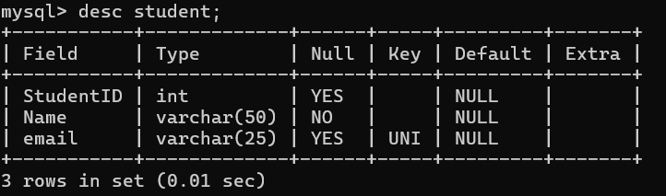
UNIQUE Constraint (on Student table)
CREATE TABLE Student12 (
StudentID INT,
Email VARCHAR(100) UNIQUE ); -- Email must be unique
INSERT INTO Student3 (StudentID, Email) VALUES (1, 'a@abc.com'); -- OK
INSERT INTO Student3 (StudentID, Email) VALUES (2, 'a@abc.com'); -- Error: Duplicate Email
INSERT INTO Student3 (StudentID, Email) VALUES (3, null);

Slide 7
CHECK
Using the CHECK constraint we can specify a condition for a field, which should be satisfied at the time of entering values for this field.
CREATE TABLE student7
(
ID int NOT NULL,
NAME varchar(10) NOT NULL,
AGE int NOT NULL , CHECK (AGE >= 18)
);
insert into student7 values(1001,'jayaprakash',20);
insert into student7 values(1002,'Latha',17);
Check constraint 'student7_chk_1' is violated.

Slide 8
DEFAULT Constraint (on Student Status)
CREATE TABLE Student6 (
StudentID INT PRIMARY KEY,
Name VARCHAR(50),
Status VARCHAR(20) DEFAULT 'Active'
);
-- Don't provide status
INSERT INTO Student6 (StudentID, Name) VALUES (1, 'Nisha');
-- Status will be 'Active'
-- Provide status explicitly
INSERT INTO Student6 (StudentID, Name, Status) VALUES (2, 'Kishore', 'Inactive'); -- OK

Slide 9
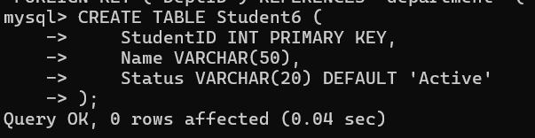
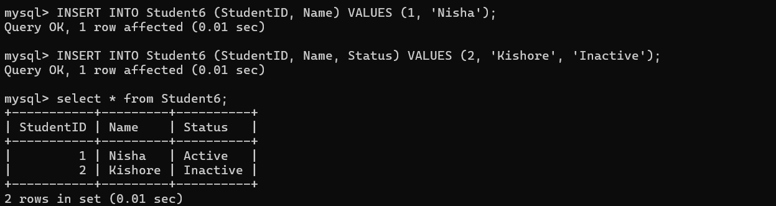

Slide 10
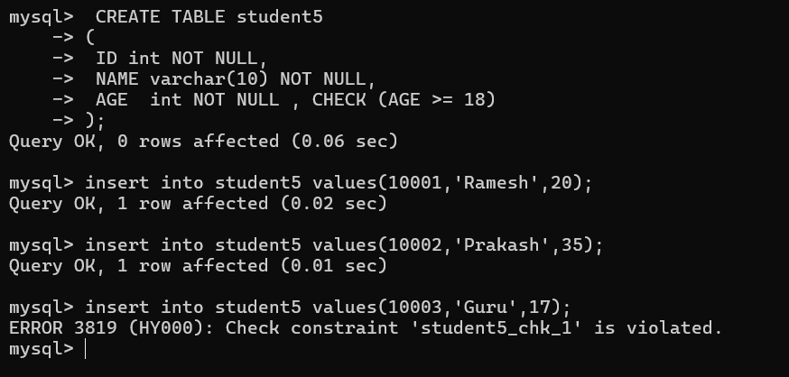

Slide 11
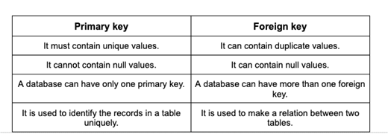
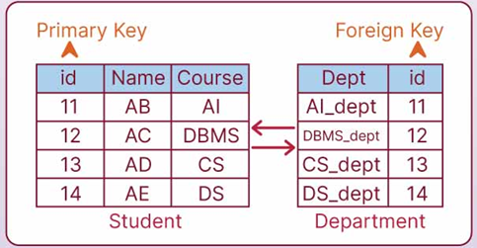
Difference between primary / foreign key

Slide 12
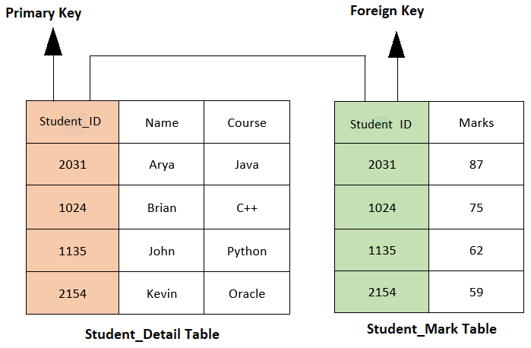
Difference between primary / foreign key

Slide 13
Primary Key:
Primary Key is a field which uniquely identifies each row in the table.
then the field will not be able to contain NULL values as well as all the rows should have unique values for this field.
a. CREATE TABLE Student14(
studID int primary key, -- Column Level
studName varchar(20) not null,
studAddress varchar(20) );
b. CREATE TABLE Student15(
studID int,
studName varchar(20) not null,
studAddress varchar(20) ,
primary key(studID)); -- Table Level

Slide 14
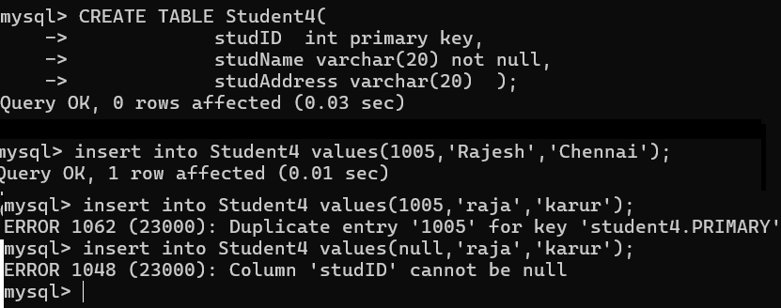
Primary Key

Slide 15
FOREIGN KEY Constraint (Student → Department)
--Parent table
CREATE TABLE Department22 (
DeptID INT PRIMARY KEY,
DeptName VARCHAR(50));
--Child Table
CREATE TABLE Student22 (
StudentID INT PRIMARY KEY,
Name VARCHAR(50),
DeptID INT,
FOREIGN KEY (DeptID) REFERENCES Department22(DeptID));

Slide 16
FOREIGN KEY Constraint (Student → Department)
-- Insert valid department first(parent table)
INSERT INTO Department22 VALUES (101, 'CSE');
-- Now insert student with matching DeptID (childtable)
INSERT INTO Student22 VALUES (1, 'Meena', 101); -- OK
-- Try with non-existing DeptID
INSERT INTO Student22 VALUES (2, 'Ram', 999); -- Error: No DeptID = 999

Slide 17
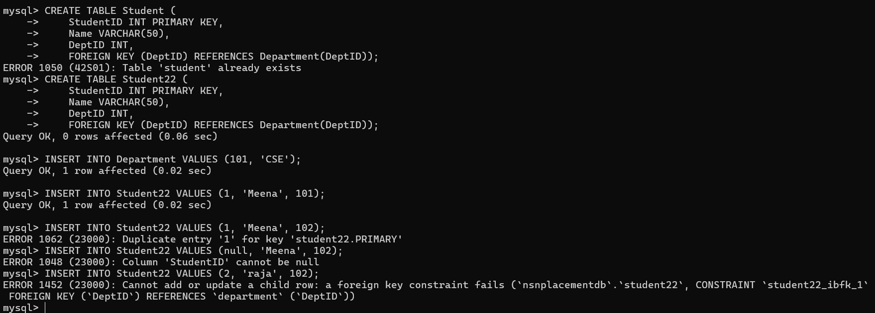

Slide 18
FOREIGN KEY: (Order → Custormer
Foreign Key is a field in a table which uniquely identifies each row of another table.
. Create Customers Table
CREATE TABLE Customers (
C_ID INT PRIMARY KEY, -- Unique customer ID
NAME VARCHAR(15) NOT NULL, -- Name is required
ADDRESS VARCHAR(15) NOT NULL -- Address is required
);
Create Orders Table
CREATE TABLE Orders (
O_ID INT, -- Order ID
ORDER_NO INT NOT NULL, -- Order number is required
C_ID INT, -- Foreign key to Customers
PRIMARY KEY (O_ID), -- Order ID must be unique
FOREIGN KEY (C_ID) REFERENCES Customers(C_ID) -- Customer must exist
);

Slide 19
INSERT INTO Customers (C_ID, NAME, ADDRESS) VALUES
(1, 'Ravi', 'Chennai'),
(2, 'Divya', 'Madurai'),
(3, 'Arun', 'Salem');
Insert Data into Orders
INSERT INTO Orders (O_ID, ORDER_NO, C_ID)VALUES
(101, 5001, 1), -- Valid: C_ID 1 exists in Customers
(102, 5002, 2), -- Valid: C_ID 2 exists in Customers
(103, 5003, 3); -- Valid: C_ID 3 exists
(104,5004,4); -- Error: C_ID 4 does not exist in parent table

Slide 20
Combined Table with All Constraints:
CREATE TABLE Department (
DeptID INT PRIMARY KEY,
DeptName VARCHAR(50)
);
CREATE TABLE Student (
StudentID INT PRIMARY KEY, -- Unique ID
Name VARCHAR(50) NOT NULL, -- Name required
Email VARCHAR(100) UNIQUE, -- No duplicate emails
Age INT CHECK (Age >= 18), -- Only 18+
DeptID INT,
Status VARCHAR(20) DEFAULT 'Active', -- Default value
FOREIGN KEY (DeptID) REFERENCES Department(DeptID)); -- Link to Dept table

Slide 21
Test Queries for Practice:
-- Create Department
INSERT INTO Department VALUES (1, 'CSE');
-- Insert Student
INSERT INTO Student (StudentID, Name, Email, Age, DeptID)
VALUES (101, 'Divya', 'divya@gmail.com', 19, 1);
-- Check default value
SELECT * FROM Student;

Slide 22
Problem Statement # Two tables: Primary and Foreign Key
Department : Stores department details.
Employee : Stores employee details and references the department they belong to.
1.Create Department Table (with Primary Key)
CREATE TABLE Department (
dept_id INT PRIMARY KEY,
dept_name VARCHAR(100)
);
note:
dept_id is the primary key — uniquely identifies each department

Slide 23
2. Create Employee Table (with Foreign Key)
CREATE TABLE Employee (
emp_id INT PRIMARY KEY,
emp_name VARCHAR(20),
dept_id INT,
FOREIGN KEY (dept_id) REFERENCES Department(dept_id)
);
note:
emp_id is the primary key — uniquely identifies each employee.
dept_id is a foreign key — refers to Department.dept_id, establishing a relationship.

Slide 24
Data Insertion:
-- Insert into Department
INSERT INTO Department (dept_id, dept_name) VALUES
(1, 'HR'),
(2, 'Engineering'),
(3, 'Marketing');
-- Insert into Employee
INSERT INTO Employee (emp_id, emp_name, dept_id) VALUES
(101, 'Alice', 1),
(102, 'Bob', 2),
(103, 'Charlie', 2);

Slide 25
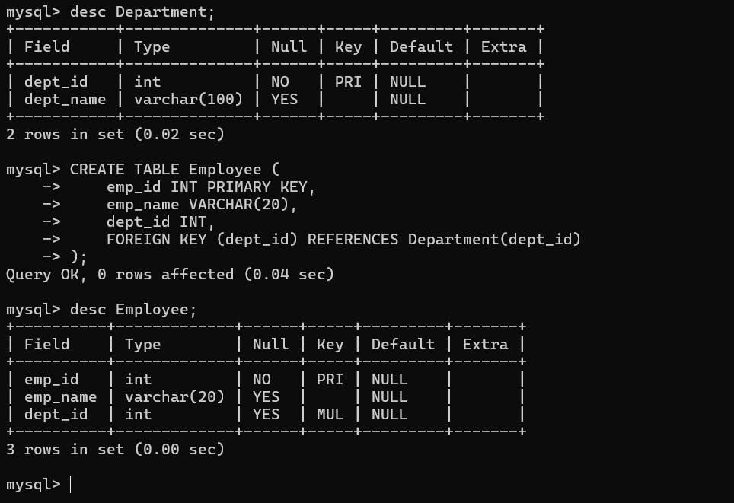

Slide 26
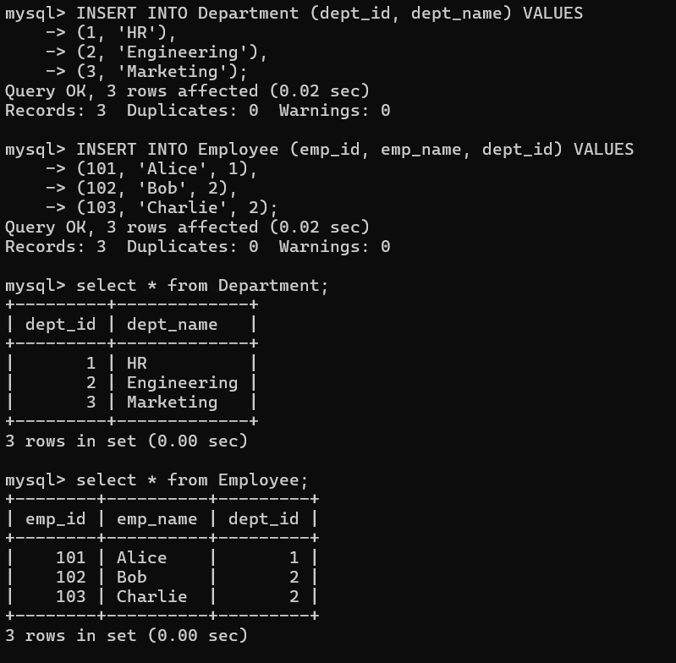

Slide 27
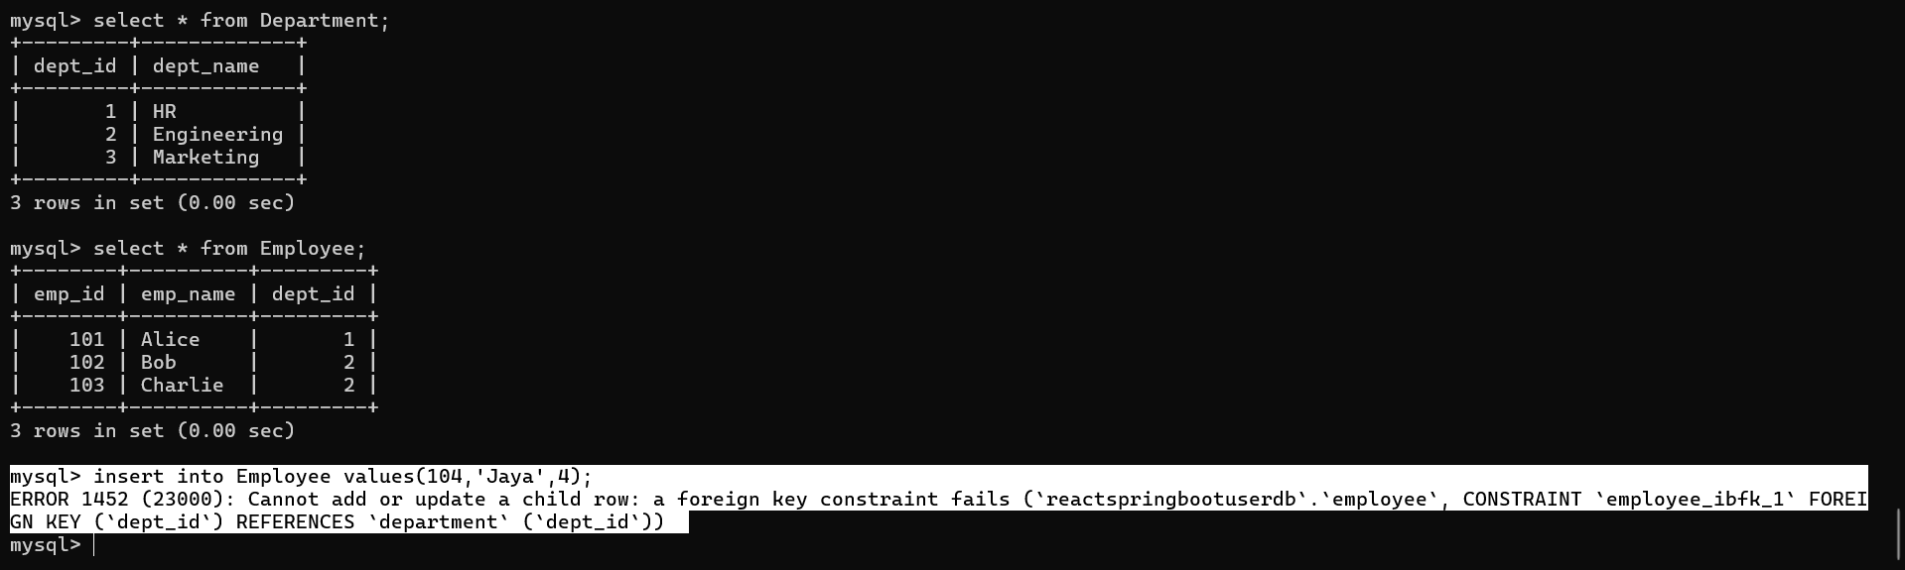
Error occur :

Slide 28
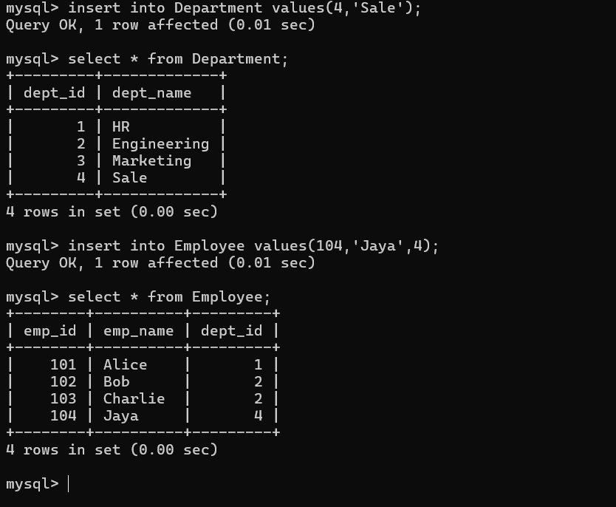
Working properly : Parent and child relationship table

Slide 30
What is a SubQuery?
A Subquery is a query inside another query. It is also called a nested query or inner query. The main query (outer query) uses the result of the subquery.
Subqueries are usually written inside:
SELECT
FROM
WHERE clauses.
Basic Syntax
SELECT column_name
FROM table_name
WHERE column_name operator (SELECT column_name FROM another_table WHERE condition);

Slide 31
Why use a SubQuery?
To perform step-by-step filtering of data.
To break down complex logic into smaller parts.
To compare results of one query with another.

Slide 32
Single Row SubQuery – returns one value.
student_id | name | marks
1 | Ram | 80
2 | Rahul | 90
3 | Priya | 85
4 | Seema | 92

Slide 33
SubQuery in WHERE Clause (Single Row)
Problem: Get students who scored more than average marks.
SELECT name, marks
FROM Students
WHERE marks > (SELECT AVG(marks) FROM Students);
SubQuery:
SELECT AVG(marks) FROM Students;
AVG(marks)
----------
86.75

Slide 34
output
name | marks
Rahul | 90
Seema | 92

Slide 35
SubQuery with IN (Multiple Row SubQuery)
Problem: Get students in top 2 marks.
SELECT name, marks
FROM Students
WHERE marks IN (SELECT marks FROM Students ORDER BY marks DESC LIMIT 2);

Slide 36
What does ORDER BY ... DESC LIMIT 2 mean?
ORDER BY → Sorts the result.
DESC → Sorts in descending order (highest to lowest).
LIMIT 2 → Shows only the top 2 results from the sorted list.

Slide 37
Step-by-step:
ORDER BY marks DESC → Sorts by marks from highest to lowest:
92 (Seema)
90 (Rahul)
85 (Priya)
80 (Ram)
LIMIT 2 → Takes only the first 2 rows after sorting:
90
92

Slide 38
name | marks
Rahul | 90
Seema | 92
Clause | Meaning
ORDER BY | Sorts the rows
DESC | High to low (descending)
LIMIT 2 | Show top 2 rows only

Slide 39
SubQuery in FROM Clause
Problem: Find average marks of students who scored more than 85.
SELECT AVG(marks) AS avg_high_scorers
FROM (SELECT marks FROM Students WHERE marks > 85) ;
Inner SubQuery:
SELECT marks FROM Students WHERE marks > 85;
marks
-----
90
92

Slide 40
Output
avg_high_scorers
91.00

Slide 41
Find the Employee with the Second Highest Salary
Problem Statement:
Write a query to display the second highest salary from the Employee table using a nested subquery.
Employee
EmpID | EmpName | Salary
1 | Ravi | 45000
2 | Priya | 55000
3 | Kiran | 60000
4 | Meena | 70000

Slide 42
SELECT EmpName, Salary
FROM Employee
WHERE Salary = (
SELECT MAX(Salary)
FROM Employee
WHERE Salary < (
SELECT MAX(Salary) FROM Employee
)
);
:

Slide 43
Find Students Who Scored Above the Class Average
Problem Statement:
Find the names of students whose marks are above the overall class average using nested subqueries.
StudentID | Name | Marks
1 | Arun | 85
2 | Bala | 65
3 | Divya | 90
4 | Rani | 70

Slide 44
SELECT Name, Marks
FROM Student
WHERE Marks > (
SELECT AVG(Marks)
FROM (
SELECT Marks FROM Student
) AS SubQuery
);
Name | Marks
Arun | 85
Divya | 90

Slide 45
Student Table
id | name | marks | dept_id
1 | Arjun | 85 | 101
2 | Priya | 90 | 102
3 | Ravi | 78 | 101
4 | Sneha | 92 | 103
5 | Kiran | 88 | 102
Departments Table
dept_id | dept_name
101 | CSE
102 | IT
103 | ECE

Slide 46
Simple Subquery
Find students who belong to the "IT" department
SELECT name
FROM students
WHERE dept_id = (
SELECT dept_id
FROM departments
WHERE dept_name = 'IT');
Kiran
Priya

Slide 47
Subquery with Comparison
Find students who scored more than the average marks
SELECT name, marks
FROM students
WHERE marks > (
SELECT AVG(marks)
FROM students);

Slide 48
name | marks
Arjun | 85
Priya | 90
Sneha | 92
Kiran | 88

Slide 49
Subquery with IN
Used when the subquery returns multiple values.
Find students who belong to either CSE or IT department.
SELECT name
FROM students
WHERE dept_id IN (
SELECT dept_id
FROM departments
WHERE dept_name IN ('CSE', 'IT')
);

Slide 50
Output:
name
Arjun
Ravi
Priya
Kiran

Slide 51
Subquery with NOT IN
SELECT name
FROM students
WHERE dept_id NOT IN (
SELECT dept_id
FROM departments
WHERE dept_name = 'IT'
);

Slide 52
name
Arjun
Ravi
Sneha

Slide 53
Problem Statement:
Create a database for a Company that stores details of Departments and Employees.
Each employee must belong to a department. Apply constraints like NOT NULL, CHECK, UNIQUE, PRIMARY KEY, and FOREIGN KEY.

Slide 54
Table 1: Department
Column Name | Data Type | Constraint | Description
dept_id | INT | PRIMARY KEY | Unique ID for each department
dept_name | VARCHAR(50) | NOT NULL, UNIQUE | Department name (must be unique)
location | VARCHAR(50) | NOT NULL | Location of department

Slide 55
Table 2: Employee
Column Name | Data Type | Constraint | Description
emp_id | INT | PRIMARY KEY | Unique ID for each employee
emp_name | VARCHAR(50) | NOT NULL | Employee name
age | INT | CHECK (age >= 18) | Minimum age must be 18
email | VARCHAR(100) | UNIQUE | No two employees share same email
salary | DECIMAL(10,2) | CHECK (salary > 0) | Salary must be positive
dept_id | INT | FOREIGN KEY REFERENCES Department(dept_id) | Employee belongs to department

Slide 56
SQL Queries
Create Department Table
CREATE TABLE Department (
dept_id INT PRIMARY KEY,
dept_name VARCHAR(50) NOT NULL UNIQUE,
location VARCHAR(50) NOT NULL
);
Create Employee Table
CREATE TABLE Employee (
emp_id INT PRIMARY KEY,
emp_name VARCHAR(50) NOT NULL,
age INT CHECK (age >= 18),
email VARCHAR(100) UNIQUE,
salary DECIMAL(10,2) CHECK (salary > 0),
dept_id INT,
FOREIGN KEY (dept_id) REFERENCES Department(dept_id)
);

Slide 57
Sample Input
INSERT INTO Department VALUES (1, 'HR', 'Chennai');
INSERT INTO Department VALUES (2, 'IT', 'Bangalore');
INSERT INTO Employee VALUES (101, 'Arun', 25, 'arun@gmail.com', 35000, 1);
INSERT INTO Employee VALUES (102, 'Meena', 29, 'meena@gmail.com', 50000, 2);
emp_id | emp_name | age | email | salary | dept_id | dept_name | location
101 | Arun | 25 | arun@gmail.com | 35000.00 | 1 | HR | Chennai
102 | Meena | 29 | meena@gmail.com | 50000.00 | 2 | IT | Bangalore

Slide 58
Sample Input 2 (Check Constraint Violation)
INSERT INTO Employee VALUES (103, 'Kumar', 16, 'kumar@gmail.com', 20000, 1);
Expected Output 2
ERROR: CHECK constraint failed: age >= 18
Sample Input 3 (Unique Constraint Violation)
INSERT INTO Employee VALUES (104, 'Anitha', 24, 'arun@gmail.com', 40000, 2);
Expected Output 3
ERROR: UNIQUE constraint failed: email

Slide 59
Sample Input 4 (Foreign Key Violation)
INSERT INTO Employee VALUES (105, 'Ravi', 28, 'ravi@gmail.com', 42000, 5);
Expected Output 4
ERROR: FOREIGN KEY constraint failed: dept_id does not exist in Department

Slide 61
Problem 1 — Find students who belong to “IT” department
Write an SQL query using a subquery to find all students who belong to the IT department.
students
id | name | marks | dept_id
1 | Arjun | 85 | 101
2 | Priya | 90 | 102
3 | Ravi | 78 | 101
4 | Sneha | 92 | 103
5 | Kiran | 88 | 102

Slide 62
Departments
dept_id | dept_name
101 | CSE
102 | IT
103 | ECE

Slide 63
SELECT name
FROM students
WHERE dept_id = (
SELECT dept_id
FROM departments
WHERE dept_name = 'IT'
);
name
Priya
Kiran

Slide 64
Problem 2 — Find students with marks greater than average marks
Problem Statement:
Write a subquery to find students who scored above the class average.
id | name | marks
1 | Arjun | 87
2 | Priya | 90
3 | Ravi | 78
4 | Sneha | 92
5 | Kiran | 88

Slide 65
SQL Query
SELECT name, marks
FROM students
WHERE marks > (
SELECT AVG(marks)
FROM students
);
name | marks
Arjun | 87
Priya | 90
Sneha | 92
Kiran | 88

Slide 66
Problem 3 — Find the top scorer in each department
Use a subquery to find the highest marks in each department.
id | name | marks | dept_id
1 | Arjun | 85 | 101
2 | Priya | 90 | 102
3 | Ravi | 78 | 101
4 | Sneha | 92 | 103
5 | Kiran | 88 | 102

Slide 67
SQL Query
SELECT dept_id, name, marks
FROM students
WHERE marks IN (
SELECT MAX(marks)
FROM students
GROUP BY dept_id
);
dept_id | name | marks
101 | Arjun | 85
102 | Priya | 90
103 | Sneha | 92

Slide 68
Problem Statement — Customer Order Management with Subquery Twists
A company wants to analyze its customer orders.
You need to:
Create Customer and Orders tables (DDL).
Insert and modify sample records (DML).
Grant and revoke permissions (DCL).
Write Subquery Twists to analyze customer and order data.

Slide 69
Step 1 – DDL (Create Tables)
CREATE DATABASE OrderDB;
USE OrderDB;
CREATE TABLE Customer (
cust_id INT PRIMARY KEY,
cust_name VARCHAR(50),
city VARCHAR(50)
);
CREATE TABLE Orders (
order_id INT PRIMARY KEY,
cust_id INT,
order_date DATE,
amount DECIMAL(10,2),
FOREIGN KEY (cust_id) REFERENCES Customer(cust_id)
);

Slide 70
Step 2 – DML (Insert & Update Data)
INSERT INTO Customer VALUES
(1, 'Alice', 'Chennai'),
(2, 'Bob', 'Bangalore'),
(3, 'Charlie', 'Chennai'),
(4, 'David', 'Mumbai'),
(5, 'Eva', 'Delhi');

Slide 71
INSERT INTO Orders VALUES
(101, 1, '2025-10-01', 2500.00),
(102, 1, '2025-10-10', 4000.00),
(103, 2, '2025-10-02', 3000.00),
(104, 3, '2025-10-03', 5000.00),
(105, 3, '2025-10-06', 2000.00),
(106, 4, '2025-10-04', 7000.00),
(107, 5, '2025-10-05', 1500.00);
-- Update one order amount
UPDATE Orders SET amount = 7500.00 WHERE order_id = 106;

Slide 72
Subquery Twists
Nested Subquery
Find all customers who have placed an order amount greater than the average order amount made by 'Alice'
SELECT cust_name
FROM Customer
WHERE cust_id IN (
SELECT cust_id
FROM Orders
WHERE amount > (
SELECT AVG(amount)
FROM Orders
WHERE cust_id = (
SELECT cust_id FROM Customer WHERE cust_name = 'Alice'
)
)
);

